Slide 1
caArray User Community Meeting
2.0.1 and 2.1.0 releases
Call in: 877-416-5524
Participant Passcode: 2627056
Centra: http://ncicb.centra.com
Meeting ID: array_march5
March 5, 2008

Slide 2
Agenda
Review of new installer released last week
Overview of 2.0.1 release
  Scope and schedule
  Preview of new screens
Planning for 2.1.0 release
  Scope and schedule
  Prototype of linking files to samples screens
Availability of training materials and recorded demo
General Q&A and user feedback

Slide 3
caArray 2.0.0 Installer update
The updated installer and the installation guide are both available from our gForge site, files tab at:
  https://gforge.nci.nih.gov/frs/?group_id=305
The new installer and the installation guide addresses following issues:
Problem with the grid service installation: The previous caArray distribution contained erroneous files in the grid service portion of the installer that prevent the grid service from functioning.
  We recommend reinstalling caArray. If you already loaded data which you’d like to retain, you can suppress the database update by setting the following parameter in the properties file.
  When running the installer, enter nodbintegration=true as a property in the caarray2-install.properties files
More configurable items were added to the installer.
More debugging hooks were created in the installer in an event, a problem is encountered.

Slide 4
caArray 2.0.1 Release
Schedule: Planning for a March 28, 2008 release
Scope: Address known issues in 2.0.0
Most current listing of items to be addressed is available in GForge (search by target_version=2.0.1 at http://gforge.nci.nih.gov/tracker/?atid=1344&group_id=305&func=browse)

Slide 5
caArray 2.0.1 – Key items addressed
[#12107] Valid Illumina SNP design files fail validation
[#12161] Retract Public Experiment doesn't remove ability to download data
Importing data files of the same name leads to duplicate object names in the experiment chain
[#12667] DataSet retrieved via API has only 1 logical probe in its DesignElement set.
[#11780] SDRF file does not validate if data files are uploaded first
[#11790] Importing IDF, SDRF, and data files without defining Array Design in Experiment Overview
[#12732] Ability to Download All Files from Experiments of Substantial Size
[#12344] Allow file Upload to occur as a background process

Slide 6
Demo of new screens in 2.0.1
[#12732] Ability to Download All Files from Experiments of Substantial Size
[#12344] Allow file Upload to occur as a background process

Slide 7
caArray 2.1.0
Schedule: Planning for a May, 2008 release
Scope: Planning in progress but will include remaining open defects plus some additional functionality
Demo:
[#12252] Provide a mechanism to allow array data files to be associated with pre-populated annotations

Slide 8
End-user training is now available
We are now offering a one-hour caArray Application Overview session at the request of our users.
  Target Audience: Anyone who is interested in the caArray Data Portal
  Description: This demonstration session provides a detailed overview of using the caArray application. It is a combination of PowerPoint presentation and live demonstration of the application.
If you are interested in attending one of these sessions, please register at:
  http://ncicbtraining.nci.nih.gov
You can also reference this information here:
  http://ncicb.nci.nih.gov/NCICB/training/caarray
A recorded caArray demo is now available:
  https://cabig.nci.nih.gov/tool_demos/caarray_demo/caArray_demo_v2.html

Slide 9
Open Q&A
Some questions to think about:
Priorities for platforms to support for parsing
Barriers to adoption
Feature priorities that have been captured but not implemented (search on target release=Deferred in the Feature tracker: https://gforge.nci.nih.gov/tracker/?atid=1341&group_id=305&func=browse)

Slide 10
Mechanisms for feedback
caArray Users listserv
  We welcome and encourage active exchanges on this listserv to share experiences with the product
Community Change Request tracker
  http://gforge.nci.nih.gov/tracker/?atid=1339&group_id=305&func=browse
This meeting
  With the product in your hands now, we will devote a significant portion of this monthly meeting to answering your questions and soliciting your feedback
  As we scope each release, we will review the priorities with the participants on this call

Slide 11
Next meeting date:
Wednesday, April 2, 2pm ET

Slide 12
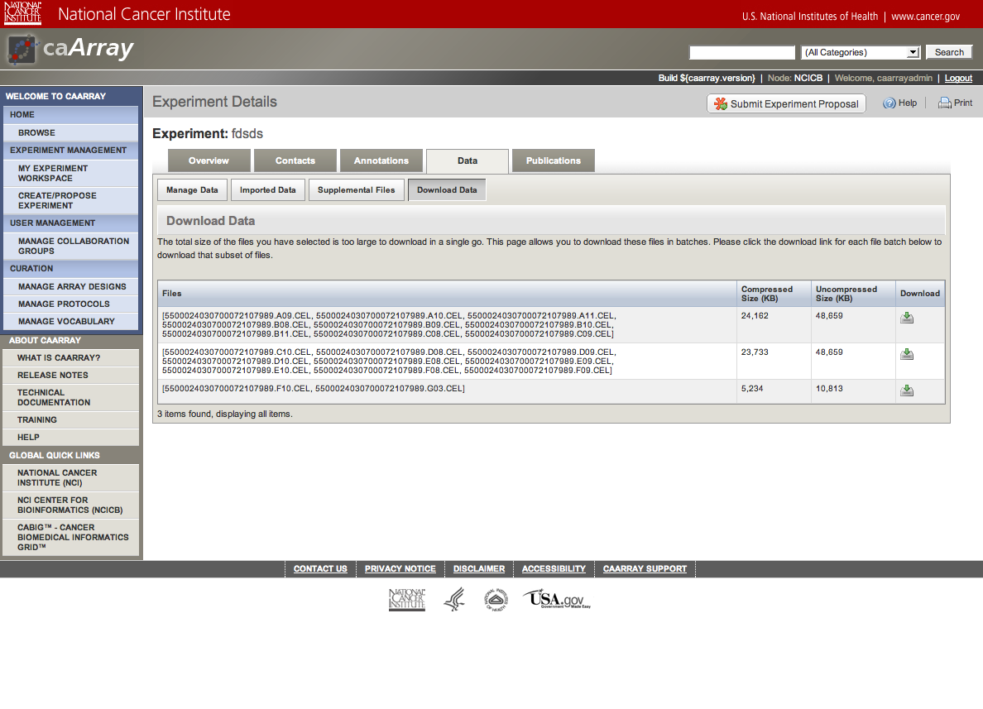
[#12732] Ability to Download All Files from Experiments of Substantial Size

Slide 13
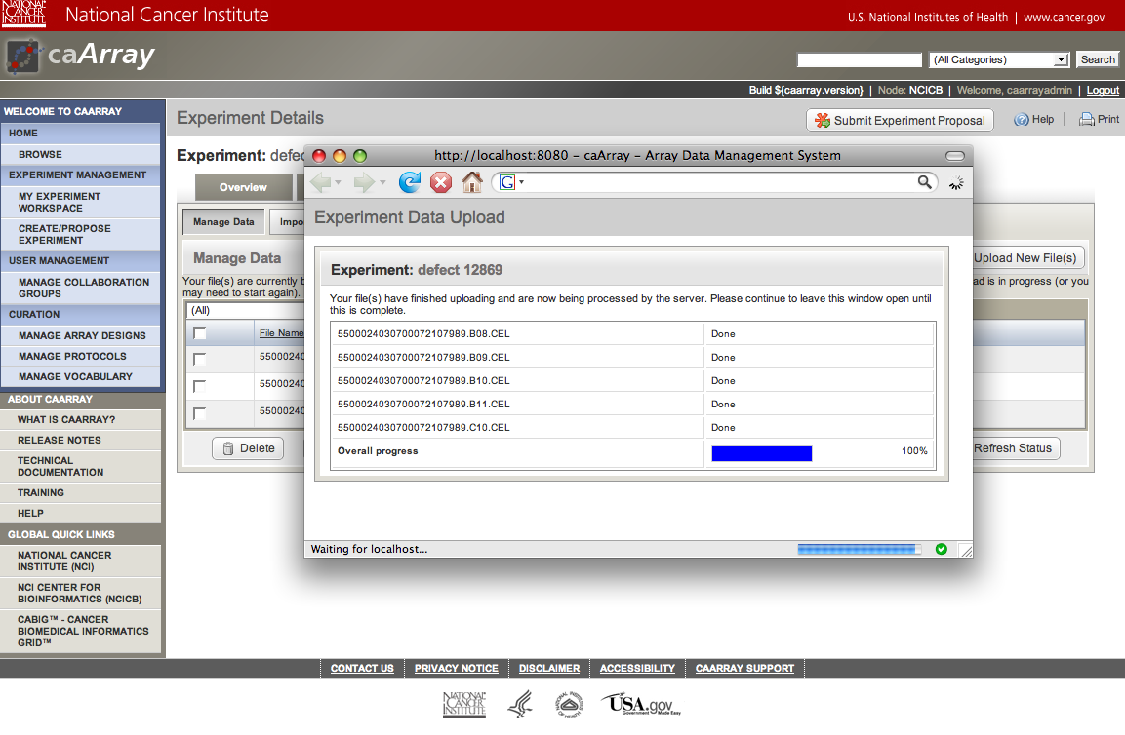
[#12344] Allow file Upload to occur as a background process

Slide 14
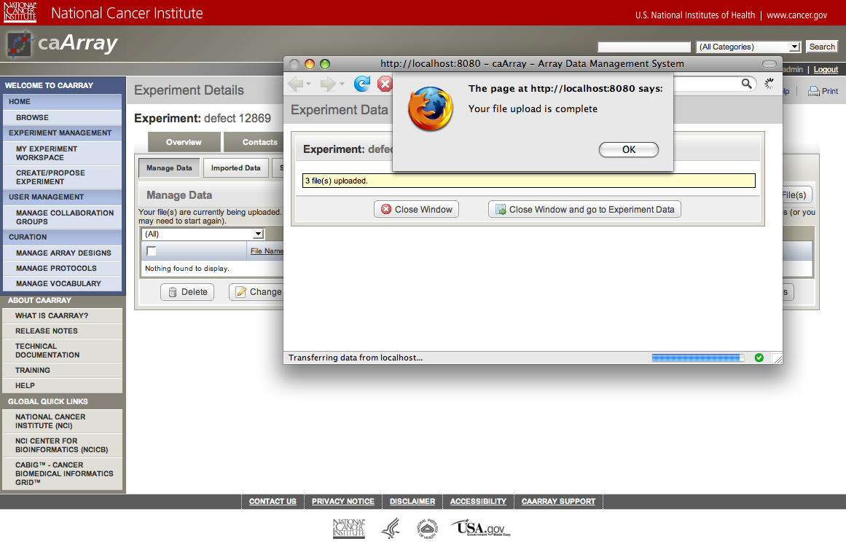
[#12344] Allow file Upload to occur as a background process

Slide 15
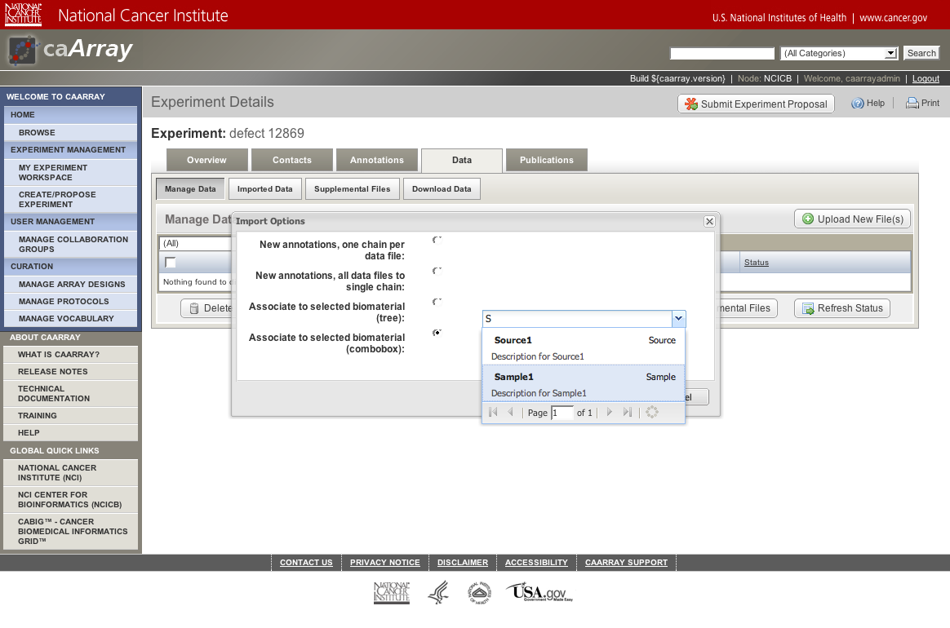
[#12252] Provide a mechanism to allow array data files to be associated with pre-populated annotations

Slide 16
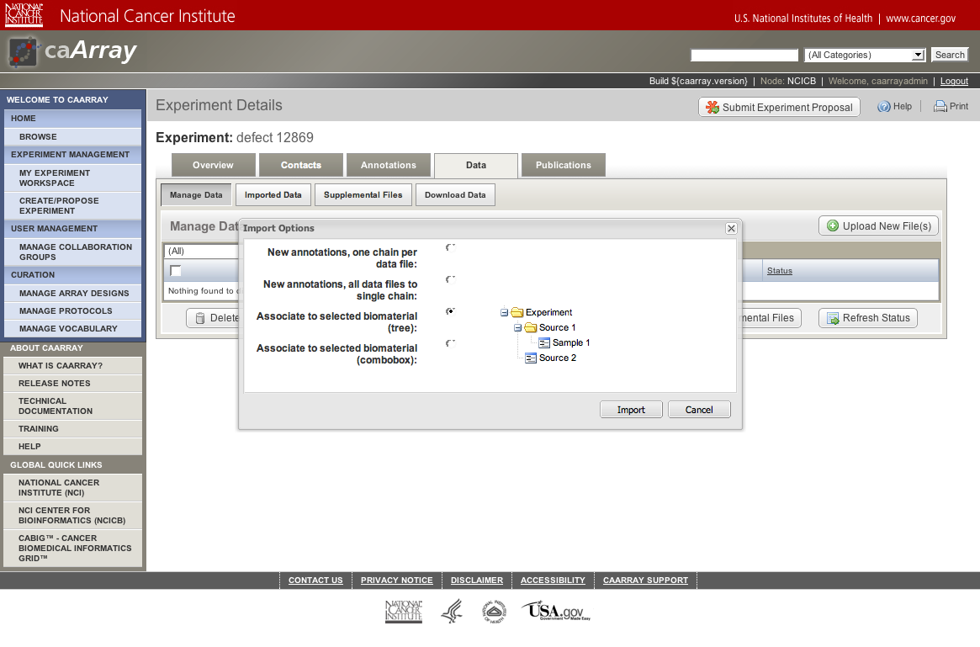
[#12252] Provide a mechanism to allow array data files to be associated with pre-populated annotations

Slide 17
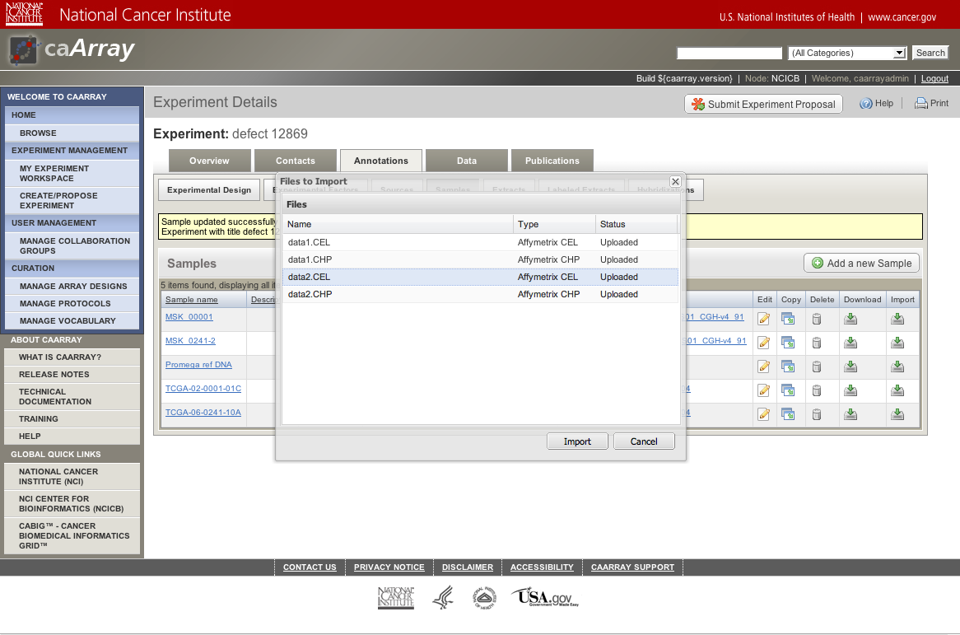
[#12252] Provide a mechanism to allow array data files to be associated with pre-populated annotations

